Slide 1
Lab Wk. 9
Stoplight State Counter
Mary Hager
Digital Design – Fall Quarter 2026

Slide 2
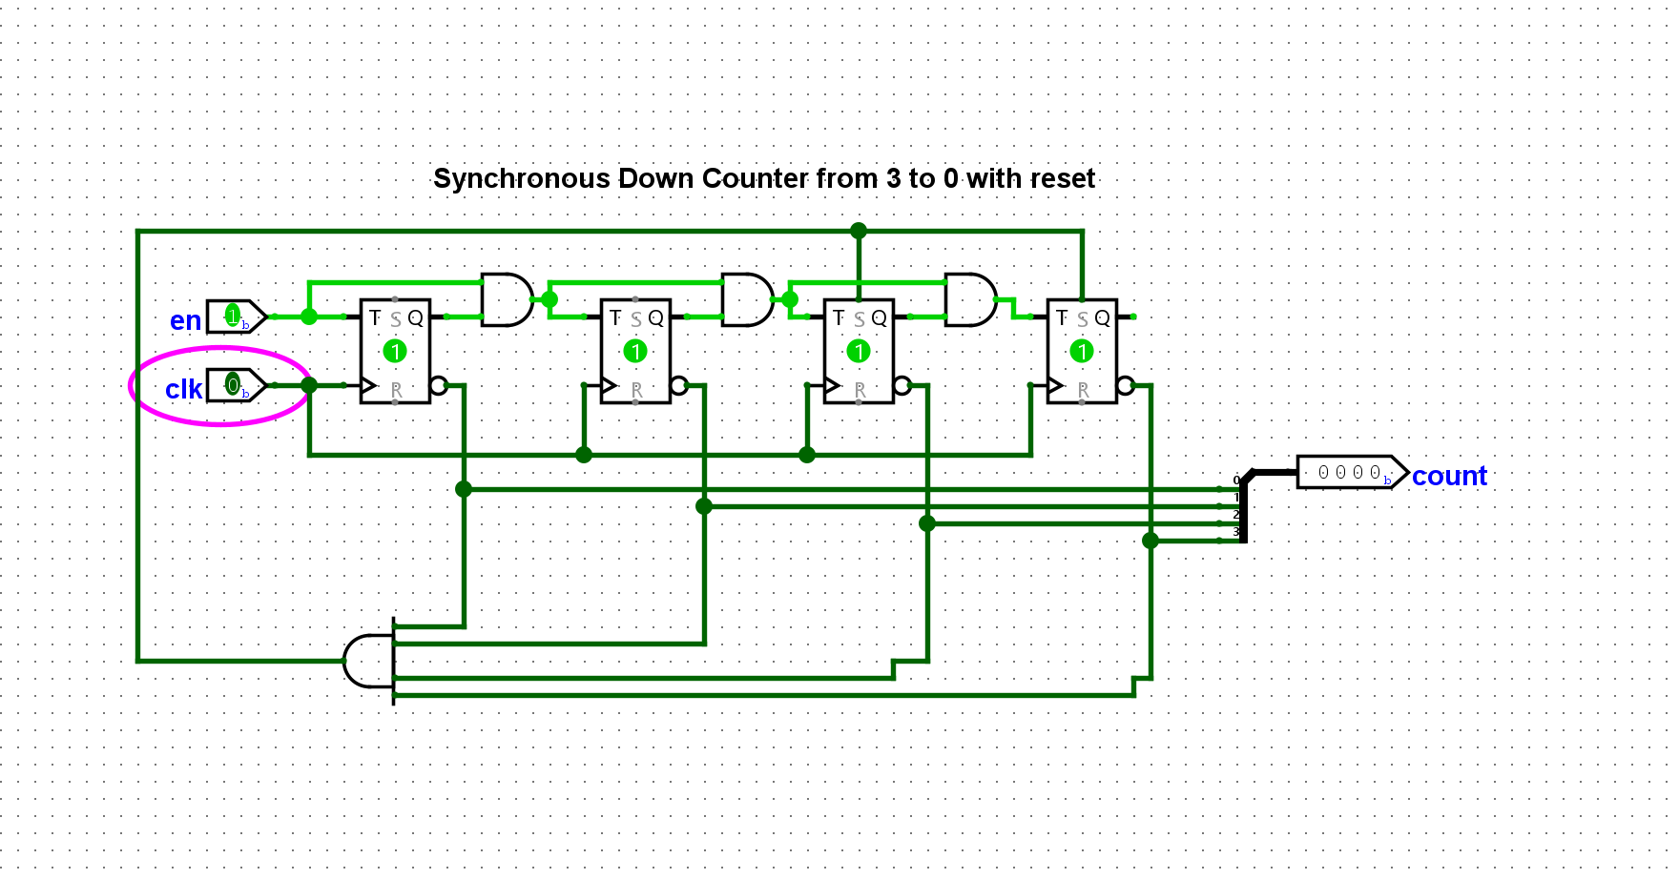
Count Down from 3 to Zero
Reset t o 3

Slide 3
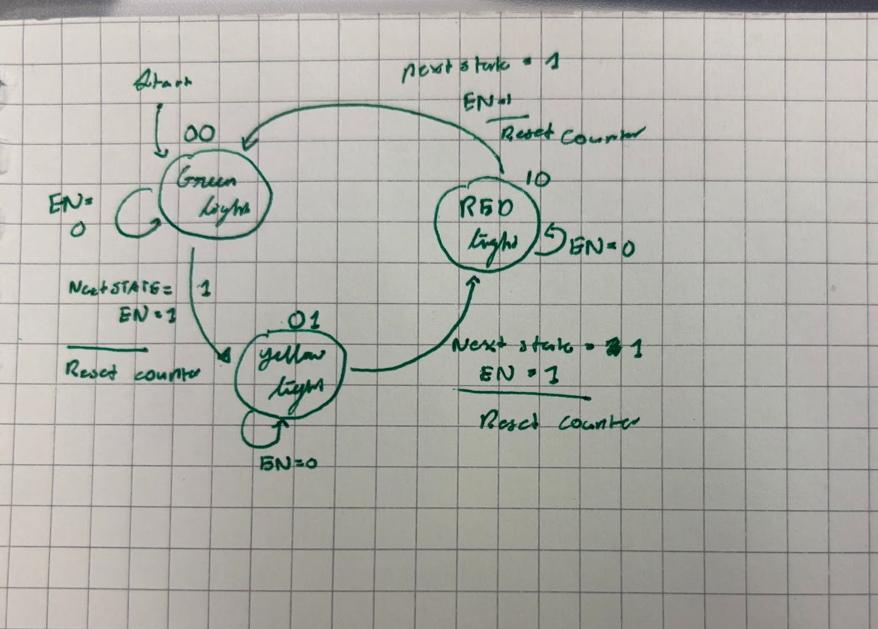
Diagram for the FSM Logic
Demonstrates the change between the display of lights.
Reset counter is an output.
NextState pin is an input that is 1 when the countdown from 3 reaches zero.
Green Light is assigned state 00
Yellow Light is assigned state 01
Red Light is assigned state 10

Slide 4
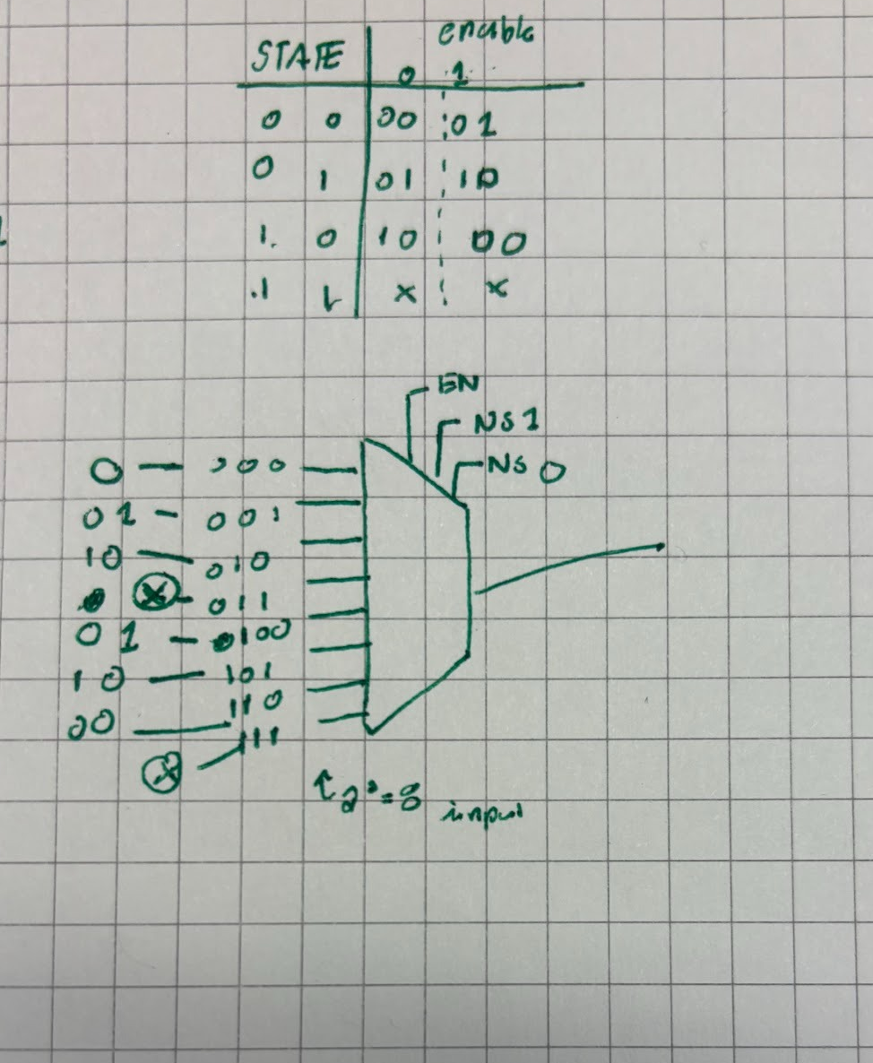
Truth Table for inputs with two bits.
Sates and enable pin determine which state the multiplexor outputs.
00 – RED
01 – YELLOW
10 – GREEN
11 – Not Used

Slide 5
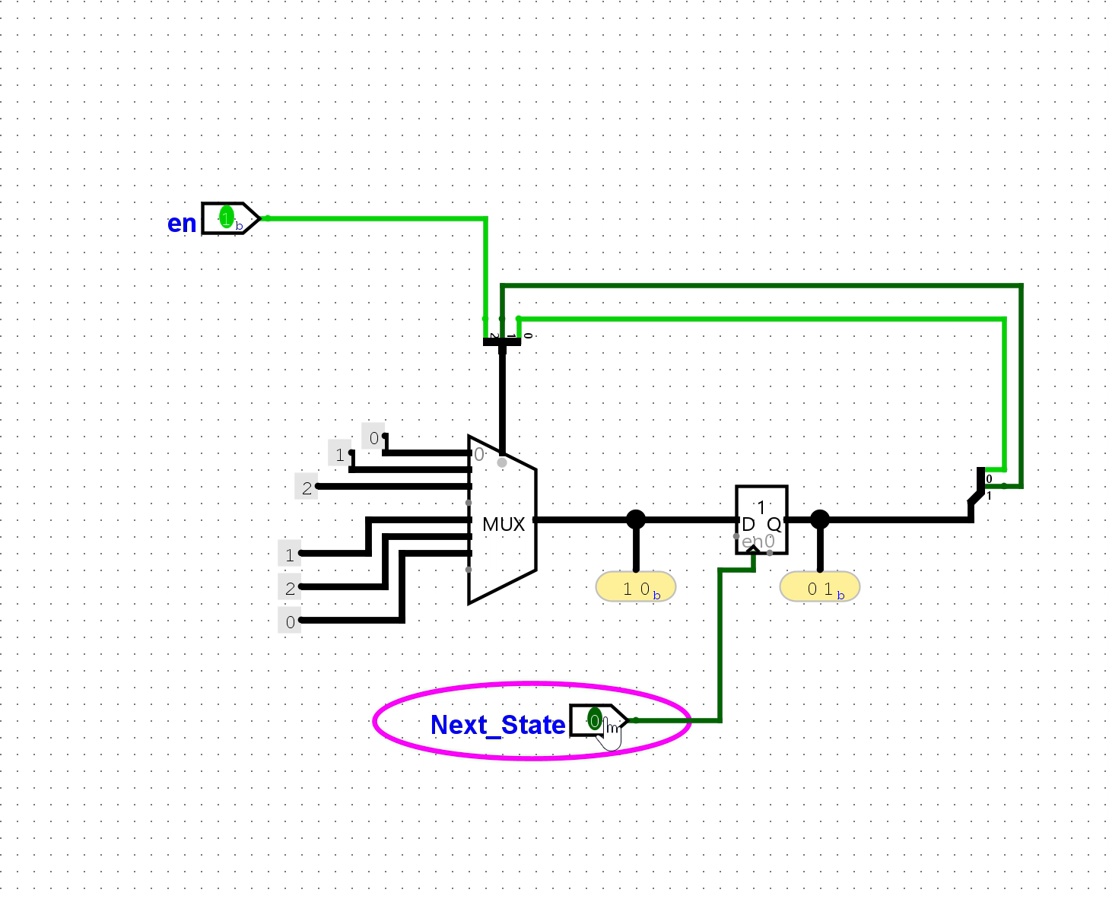
State changes being moved through based on multiplexor logic.

Slide 6
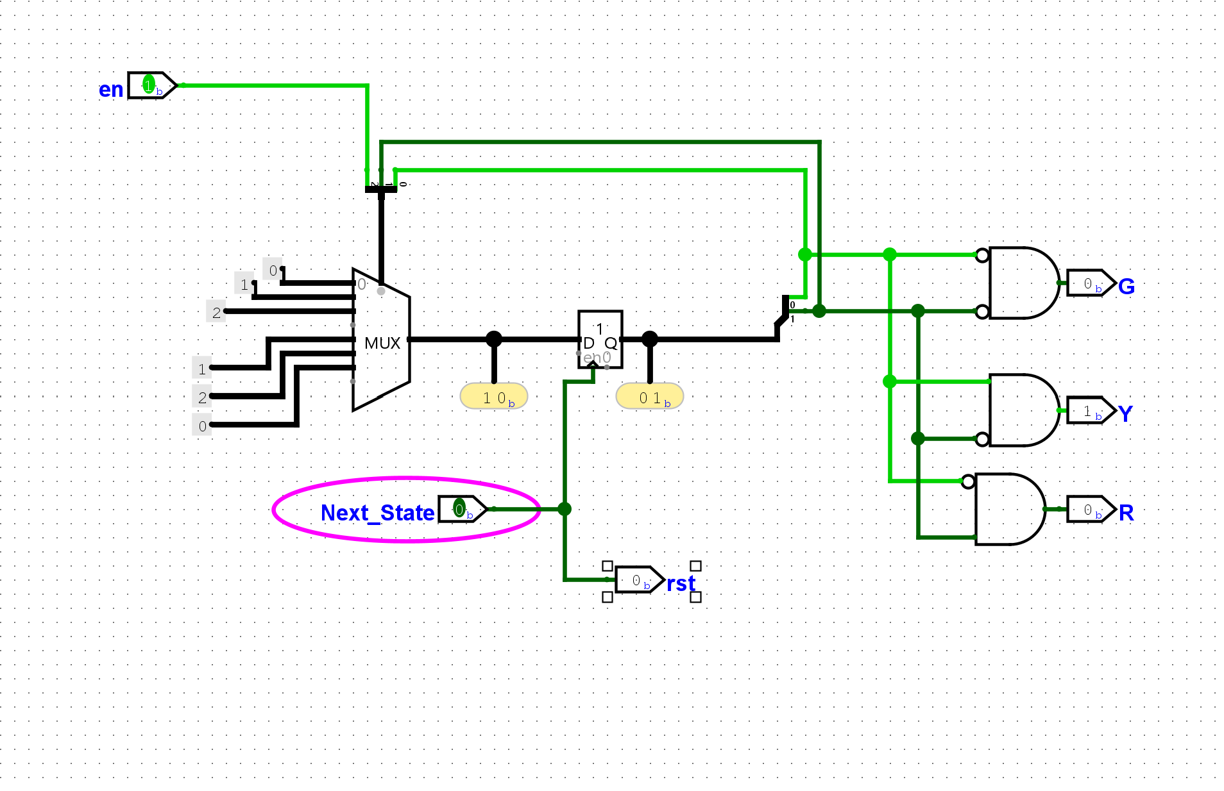
FSM State Change corresponding to shift in light outputs.

Slide 7
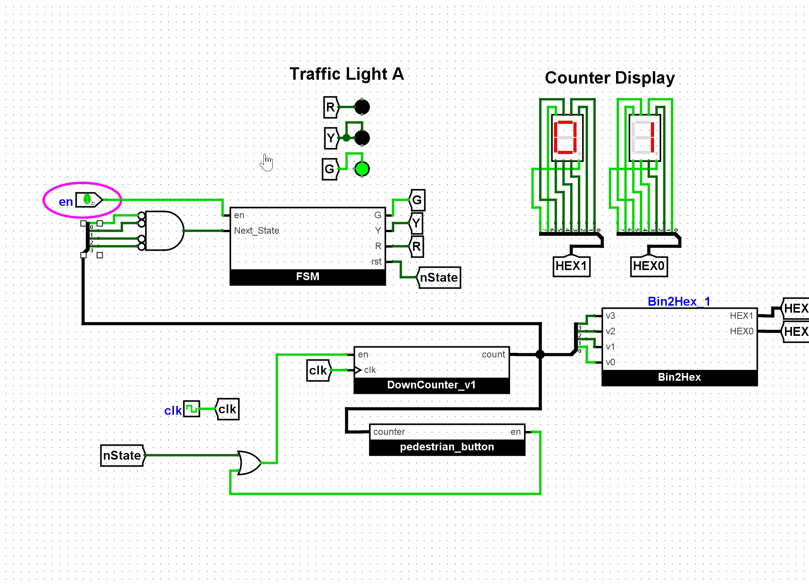
Full machine working

